Slide 1
Fall 2021 Pre-calculus
Lesson 8.4
Dr. O’Brien
Lehman High School
November 12, 2021
Notes:
Quadratic formula

Slide 2
Partner work
be sure to: Work with a partner on each problem. After finishing a section, ask Dr. O’Brien to review your answers. Be prepared to turn in one of your assignments (with both names on it).
Exam next early next week!
We’ll review the rest of the week
Topics to be covered:
Combining functions
arithmetic combinations
composition of functions
Polynomials:
Applying leading coefficient test,
finding roots,
and sketching quadratics and higher order polynomials
long division of polynomials
Quadratic formula:
For any quadratic $ax^{2}+bx+c=0$ you can find the roots x using the quadratic formula:
$$x=\frac{-b±\sqrt{b^{2}-4ac}}{2a}$$
Notes:
See answer keys. When students finish check answer record and give them extra pset.
This activity targets review for examine and meta cognitive thinking about thinking.
+HDW compute the composition of two functions? It’s substitution of on function into the x value of another.
+how do I find the domain? You want to figure out which x values are not allowed. If you have a fraction think about what x values would make the denominator equal 0, for square root think about what will make the expression inside it less than zero.
+How do you treat negative coefficients? remember to include the ‘-‘ when you plug the value into your formula
How are the answers from (3-6) useful for sketching the graph of these functions? They tell us what the x-intercepts are.
How do I find the vertex? convert to vertex form: (x +a)^2 + b, then vertex is (a,b).
How could I check my work for (3)? plug in the values of x and see if it gets you 0. You could also use another method to calculate roots, such as completing the square.

Slide 3
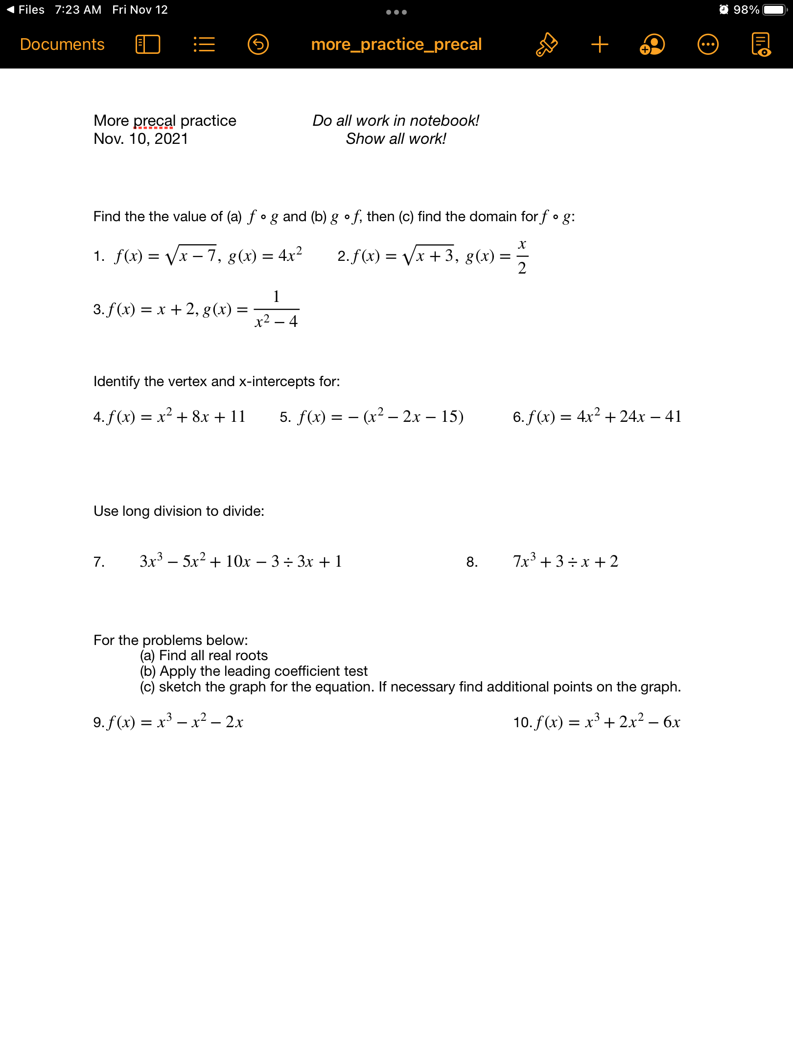
Partner work
be sure to: Work with a partner on each problem. After finishing a section, ask Dr. O’Brien to review your answers. Be prepared to turn in one of your assignments (with both names on it).
Notes:
See answer keys.
+HDW compute the composition of two functions? It’s substitution of on function into the x value of another.
+how do I find the domain? You want to figure out which x values are not allowed. If you have a fraction think about what x values would make the denominator equal 0, for square root think about what will make the expression inside it less than zero.
+How do you treat negative coefficients? remember to include the ‘-‘ when you plug the value into your formula
How are the answers from (3-6) useful for sketching the graph of these functions? They tell us what the x-intercepts are.
How do I find the vertex? convert to vertex form: (x +a)^2 + b, then vertex is (a,b).
How could I check my work for (3)? plug in the values of x and see if it gets you 0. You could also use another method to calculate roots, such as completing the square.

Slide 4
Partner work
be sure to: Work with a partner on each problem. After finishing a section, ask Dr. O’Brien to review your answers. Be prepared to turn in one of your assignments (with both names on it).
Notes:
See answer keys.

Slide 5
Partner work
be sure to: Work with a partner on each problem. After finishing a section, ask Dr. O’Brien to review your answers. Be prepared to turn in one of your assignments (with both names on it).
Notes:
See answer keys.
+

Slide 6
Partner work
be sure to: Work with a partner on each problem. After finishing a section, ask Dr. O’Brien to review your answers. Be prepared to turn in one of your assignments (with both names on it).
Notes:
See answer keys.

Slide 7
Partner work
be sure to: Work with a partner on each problem. After finishing a section, ask Dr. O’Brien to review your answers. Be prepared to turn in one of your assignments (with both names on it).
Notes:
Extra space for work.

Slide 8
d
Reflection
be sure to: Discuss in class
Exam next Friday, Nov. 12!
We’ll review the rest of the week
Topics to be covered:
Combining functions
arithmetic combinations
composition of functions
Polynomials:
Applying leading coefficient test,
finding roots,
and sketching quadratics and higher order polynomials
long division of polynomials
Review the exam topics to the right:
Which topics do you feel most/least comfortable with?
How do you plan to prepare for topics you feel least comfortable with?

